Slide 1

EE0005 Crash Revision
We will begin at 7.10 pm! .
Instructors:
(1) Philip Lee (2) Lee Jinhen

Slide 2

Our Mission
Consolidate all EEE AI activities under one roof while providing students with an avenue to learn, research and apply ML/DA/AI skills and knowledge to both academia and the industry.
Training Area with CYNAP Core system for collaboration and presentation
MLDA@EEE
FYP/DIP/URECA
Industry Projects
>17 Workshops
>1000 Trained ML practitioners
>10 Academic Projects
>30 Industry projects
>5 competition
>15 Industry Partners
18 AIO workstations
6 Deep Learning Workstations, 4 Nvidia GTX 1080i cards each
ML Career Kickstart
events
Ample space for project work
GPU Servers (4 x V100 + 6 x V100) and storage server
Workshops
&
Competition
Notes:
MLDA@EEE is a student centric lab which aims to provide a platform to empower our EEE/IEM students learning and deploying of ML and DA skills and knowledge in both academia and industry. We do so through our various events, project and activities. And as the student committee of MLDA, our mission to execute and plan those events and workshops . And how we do it, we do it through help of our state-of-the-art faculty, resource and technical support to facultice your learning journey in ML and DA which is the hot topic of the decade.. we also impact knowledge and skills for ML through our 4 different pillars of events ranging from our ML projects, industry projects and career events and workshops with competition.

Slide 3
Introduction
AI: Intelligence demonstrated by machines

Slide 4

OpenAI’s GPT-3: May 2020
https://nesslabs.com/gpt-3-future-productivity https://twitter.com/sharifshameem/status/1283322990625607681
Notes:
An example of deep learning in modern times: Generative Pre-trained Transformer 3, 175 billion machine learning parameters, someone also made an excel function which allows the API to generate

Slide 5
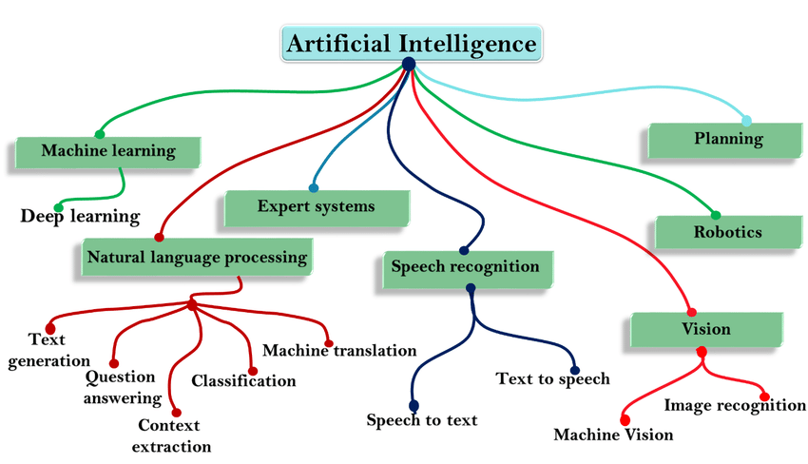
Major Subfields
Notes:
Diagram taken from https://www.researchgate.net/publication/342106972_The_role_of_Artificial_Intelligence_in_future_technology

Slide 6
Views on AI
Thinking humanly
Acting humanly
Acting rationally
Thinking rationally
Notes:
Acting rationally has a lot of logic, which can be easily learned. But grey areas raise ethical issues eg. https://www.moralmachine.net/ for self driving cars. The prospectus on AI views is quite dividing so we will not get into the details of them.

Slide 7

Turing Test
Human interrogates entity via teletype for 5 minutes. If, after 5 minutes, human cannot tell whether entity is human or machine, then the entity must be counted as intelligent
Notes:
Image taken from https://en.wikipedia.org/wiki/Turing_test

Slide 8
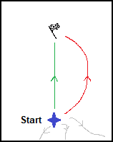
Intelligent
Agents
Notes:
Diagram from I made it myself!

Slide 9
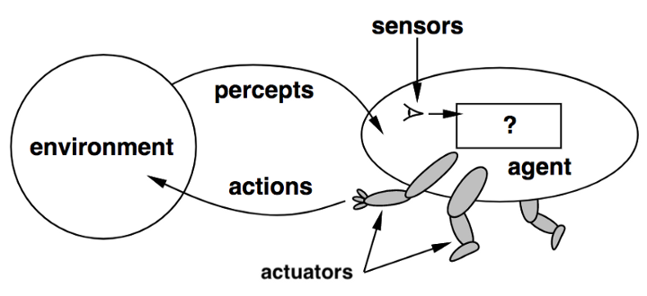
Rational Agents
An agent is an entity that perceives through sensors and acts through effectors
Rational action:
Expected value of objective performance measure (see later)
Clear preferences (hard-coded)
Choose action with optimal expected outcome
Notes:
Image from https://mc.ai/quarantine-intelligent-agents-and-vacuum-cleaner/
In the case of a autonomous robot: sensors (camera, ultraviolet sensors), effectors (motors to turn wheels, dispense item)
Hard coded rules (dont hit the wall, some distance to the wall), performance measure (how close is the agent to a path)

Slide 10
Types of Agents
Simple Reflex Agents
Agents acts based on rules and perceived data only.
1
Reflex Agents with State
Agent acts based on the previous state(s), rules and perceived data.
2
Goal-based Agents
Does the action lead the agent to a step closer to the goal?
3
Utility-based Agents
Many actions lead to the same goal. What is the utility of a certain state?
4
Autonomous Agents
Adapts to the environment through experience.
5
Notes:
Note: Ignore the pyramid hierarchy

Slide 11
Types of Environment (Example: Minesweeper)
01
Accessible / Inaccessible
Does the agent know the complete environment state?
Inaccessible. Mines are hidden so imperfect information.
02
Deterministic / Nondeterministic
Can the next state be completely determined by the current state and action taken?
Nondeterministic. Mines are randomly placed in diff. positions.
Deterministic / Nondeterministic
03
Episodic / Sequential
Does the agent require the memory of past actions to determine the next best actions, or only current percepts are important?
Sequential. The actions are based on previous outcomes.
04
Static / Dynamic
Does the environment change while the agent deliberates?
Static. When are you considering the next step, no changes in environment.
05
Discrete / Continuous
Does the environment have a discrete actions or states?
Discrete. All positions and movements are in discrete domains.
Notes:
Example of deterministic is chess → outcome of each movement can be determined
Deterministic just means that you give an input and always have the same output. In chess, if you move your piece, both you and your opponent know where it's going to end up. It doesn't randomly fail to move, it doesn't randomly end up elsewhere, it doesn't cause any surprise at all.
Example of episodic is slot machines, radiology images

Slide 12
Pop Quiz
What kind of observing environments are present in artificial intelligence?
Partial
Fully
Learning
Both Partial & Fully

Slide 13
Design of a Problem-Solving Agent
Consider the expected outcomes of different possible sequences of actions that lead to states of known value.
Steps:
Goal formulation eg. minimise Time / Distance
Problem formulation
Search process
• No knowledge → uninformed search
• Knowledge → informed search
Action execution (follow the recommended route)

Slide 14
Problem Formulation
Initial state - eg. starting position
Actions set - eg. up, down, blink
State space - all the states reachable, may be infinite
Goal test - what is the goal, may have >1 states
Cost function = Search cost (“offline”) + Execution cost (“online”)
Trade-off is required, a “good enough” solution can be found in a shorter time
Solution can be a path / a sequence of actions
Notes:
Terminal state - if the tree is finite (goal, might not necessarily satisfy constraints)

Slide 15
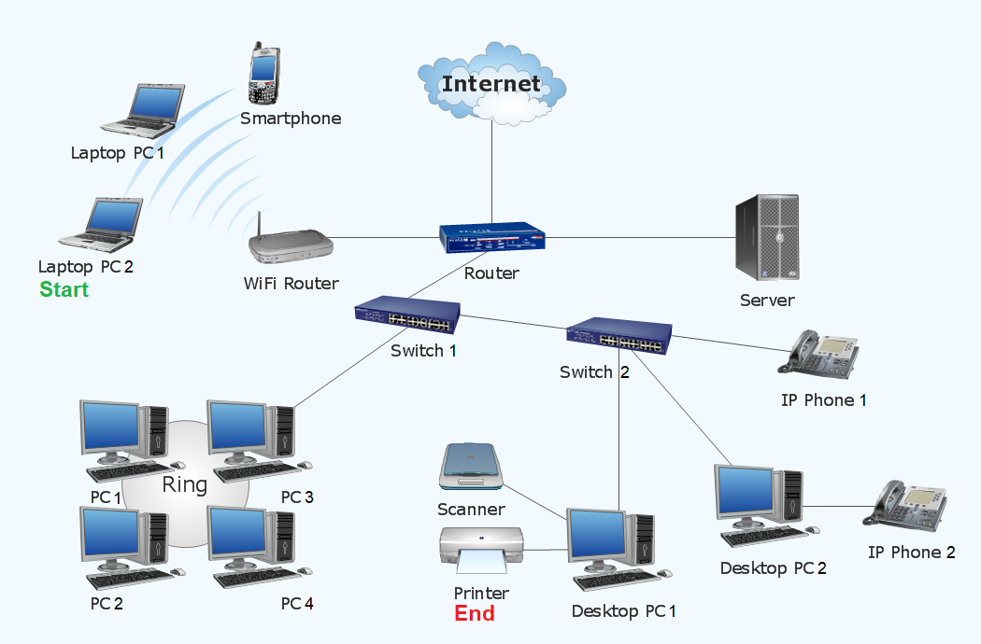
Try Yourselves! (Example: Computer Networking)
Initial state
Actions set
State space
Goal test
Cost function
Notes:
Zoom poll!

Slide 16
Search

Slide 17
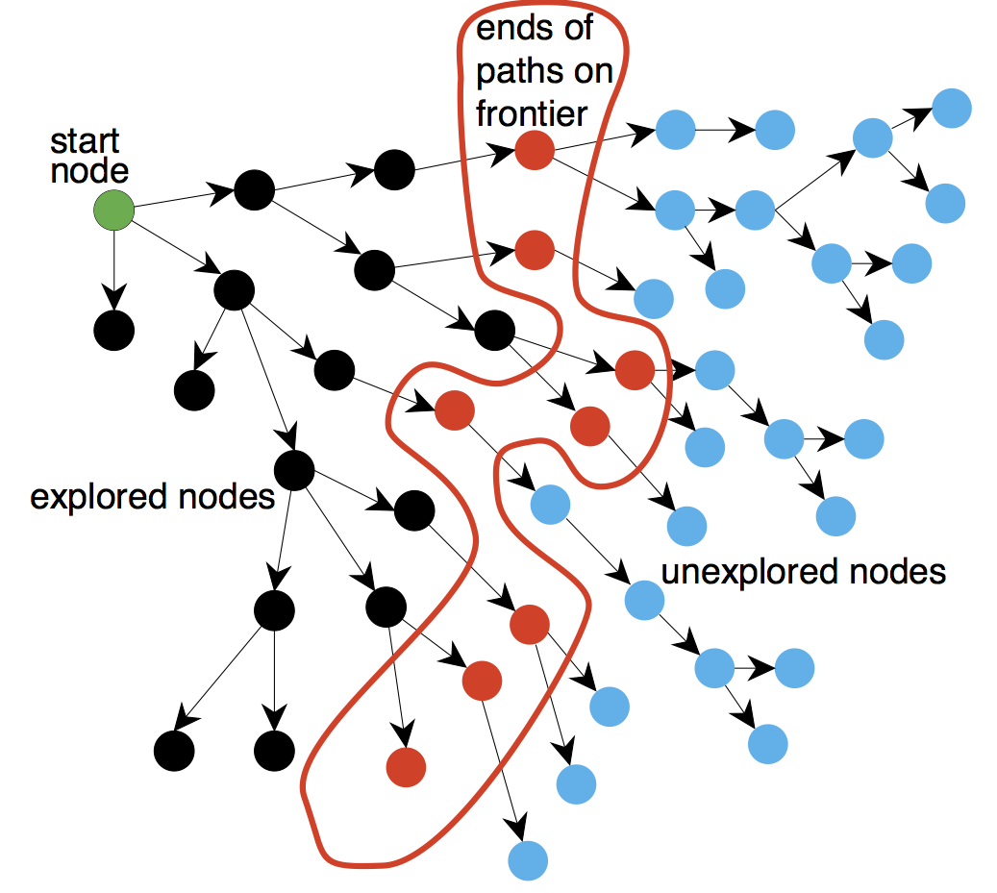
Search algorithm
Traversing the state space along a “frontier”
Frontier: Foremost unexpanded nodes
Explored nodes are stored in a “explored set” so that we don’t expand it again
Notes:
Diagram taken from http://artint.info/2e/html/ArtInt2e.Ch3.S4.html

Slide 18
Search strategy
We need a search strategy to determine which node to expand
Classified according to:
Termination: Guaranteed to terminate no matter how large the state space
Completeness: Guaranteed to find a solution (if there is one)
Time complexity: Total number of nodes expanded/generated
Space complexity: Maximum number of nodes in memory at any one time
Optimality: Guaranteed to find the best (?) solution (if there is one)
Complete algorithm
Optimal algorithm
Notes:
‘*’ means not in syllabus
Definition of ‘best’ depends on application: shortest path? Highest reward?

Slide 19
Search strategy (cont.)
Uninformed search strategies (Blind search)
Use only problem definition: no information about goal state at all
Breadth-first search
Uniform-cost search
Depth-first search
Depth-limited search
Iterative deepening search
Informed search strategies
Use problem-specific knowledge: information about goal state, “forward-looking” knowledge
Best-first search
Greedy search
A* search
Notes:
What kind of knowledge is available

Slide 20
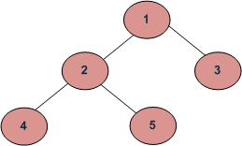
Breadth-first search/Uniform-cost search
Implemented with FIFO queue
Uniform-cost search: With priority queue
1
1 | 2 | 3
2 | 3 | 4 | 5
Notes:
BFS is optimal if all steps cost equally. Else use uniform-cost search

Slide 21
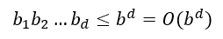
Breadth-first search/Uniform-cost search
Time complexity:
Expand every node, denote maximum branching factor b and solution path length d
Space complexity:
Solution is at the last node of the deepest level (depth d)

Slide 22
Depth-first search
Implemented with LIFO stack
Depth-limited search
Iterative deepening search
2
1
4
2
1
1
5
2
1
3
1

Slide 23
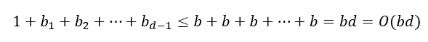
Depth-first search
Time complexity:
Expand every node, denote maximum branching factor b and maximum depth d
Space complexity:
For each node, need to store siblings (same level) to use when backtracking
Notes:
https://stackoverflow.com/questions/36479640/time-space-complexity-of-depth-first-search

Slide 24
Pop Quiz
Consider an infinite-depth search tree with small branching factor, and the goal is located at a “shallow” level. BFS is preferred over DFS in this case, why?
DFS is incomplete in this case.
BFS is much more efficient to “prune” the search tree.
DFS focuses on reaching the leaf of a particular path.
All of the above.
Notes:
Answer D
A: correct, DFS will run indefinitely for trees with infinite depth space.
B: correct, BFS can rule out nodes that is not optimal at a higher level.
C: correct, DFS will reach the solution slower if the solution is “shallow” but far from the current path

Slide 25
Evaluation function
Path cost function g(n)
Backward looking
From initial state to current state
Used in uniform-cost search
Heuristic function h(n)
Forward looking
From current state to goal state
Estimated for the cheapest path!
Admissible: a function that does not overestimate real cost of reaching the goal
Notes:
https://en.wikipedia.org/wiki/Admissible_heuristic
Use an evaluation function to estimate the “desirability" of each node

Slide 26
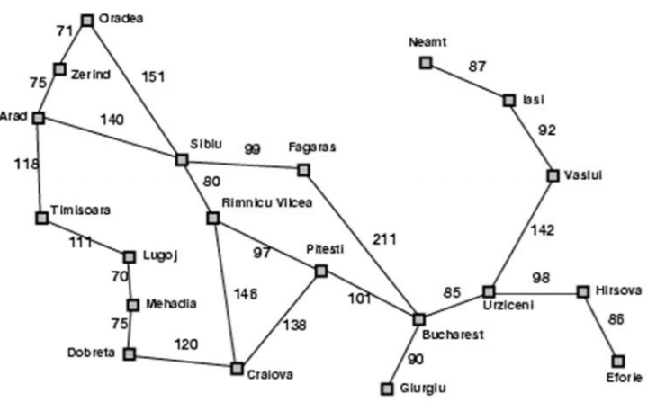
Greedy search
Greedy: Finds solution in an incremental manner based on local optimality
Expands the node which appears closest to goal
Not complete, why?
Heuristic function, h(n)
Estimate of the distance from current state to goal state
At the goal, h(goal) = 0

Slide 27
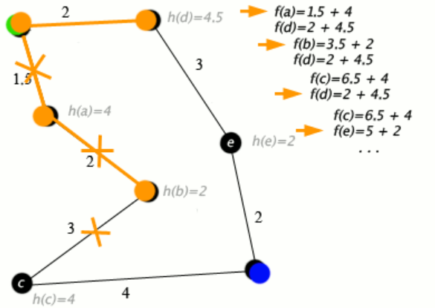
A* search
Uniform-cost search (g(n)) + Greedy search (h(n))
Total cost from start to goal, passing through node n
Evaluation function: g(n) + h(n)
Disadvantage: exponential space complexity
Store every expanded node in memory
Notes:
https://en.wikipedia.org/wiki/A*_search_algorithm

Slide 28
Constraint Satisfaction & Game Playing

Slide 29
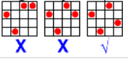
Constraint Satisfaction Problem
Goal: Discover some state that satisfies the constraints set
State: A combination of some/all variables’ arrangement with values in the domains
Eg. Variables (eg. Timetable slots), Domains (eg. Time in a working day)
An assignment that does not violate any constraints is called a consistent or legal assignment.
A solution to a CSP
Every variable given a value (complete)
The assignment satisfies all the constraints
Goal test: A set of constraints
Eg. Timetable slots cannot clash → Useful for timetable scheduling

Slide 30
Imagine this scenario - 4 Queens
4x4 grid. No two queens on the same row, column or diagonal
We search column by column
Method 1: List all possibilities, then check all
4⁴ = 64 outcomes
Time complexity: O(nⁿ)
Depth-first standard search

Slide 31
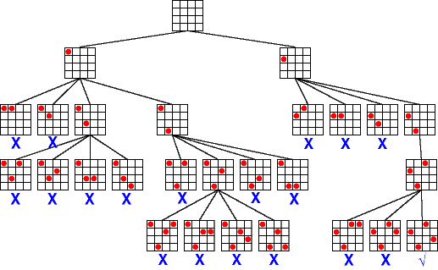
Backtracking search
Do not waste time searching when constraints have already been violated!
Notes:
If the constraint is not satisfied, then go back to the last decision point.
Image from https://ktiml.mff.cuni.cz/~bartak/constraints/propagation.html

Slide 32
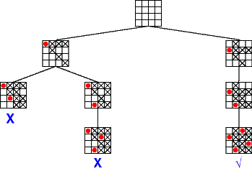
Forward tracking and constraint propagation
More ‘intelligent’ search
Implications of current variable assignments for the other unassigned variables
Which variable to assign next
What order of the values to try for each variable
Note:
Keep track of remaining legal values for unassigned variables
Terminate search when any variable has no legal values
Notes:
Image from https://ktiml.mff.cuni.cz/~bartak/constraints/propagation.html

Slide 33
How to reduce search size?
More ‘intelligent’ search - 1 important method, 3 heuristics
Wikipedia:
A heuristic technique, or a heuristic, is any approach to problem solving or self-discovery that employs a practical method that is not guaranteed to be optimal, perfect, or rational, but is nevertheless sufficient for reaching an immediate, short-term goal or approximation.
Notes:
We will be discussing 3 heuristics today!

Slide 34
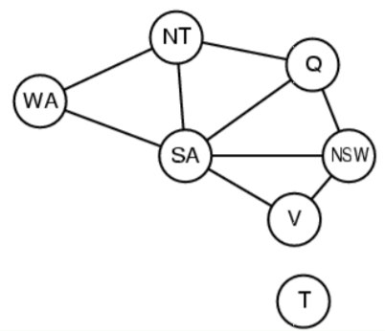
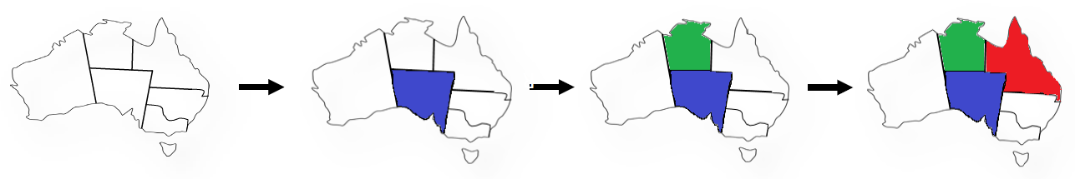
Which variable to fill first?
Which variable to assign next
What order of the values to try for each variable
Most Constrained Variable (aka minimum remaining values heuristic)
Choose the variable with the fewest legal values
Reduces the branching factor on future choices!
Notes:
Image from https://www.ics.uci.edu/~welling/teaching/271fall09/CSP271fall09.pdf

Slide 35
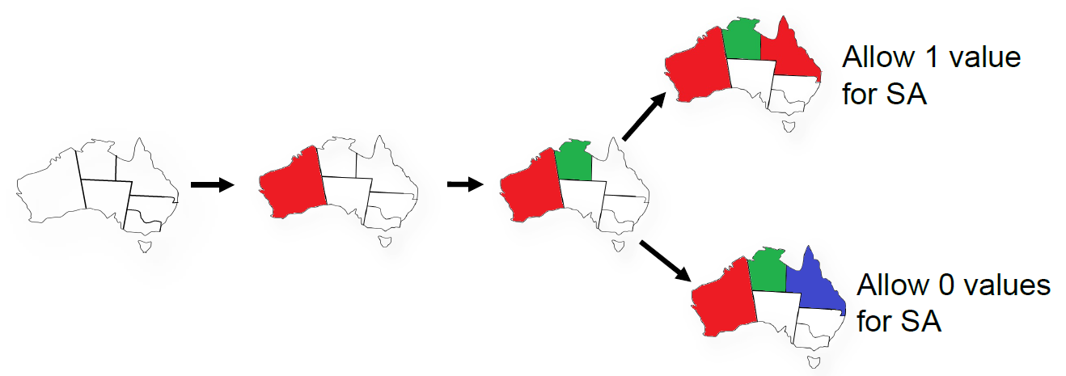
Least Constraining Value Heuristic
Choose the variable that rules out the fewest values / allows maximum flexibility in the remaining variables.

Slide 36
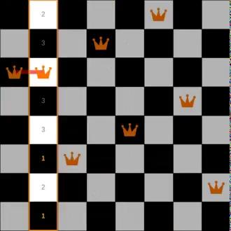
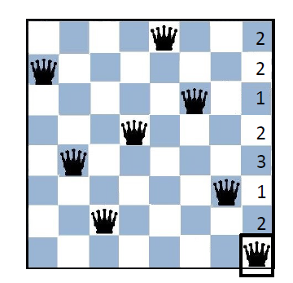
Min-Conflicts Heuristic
Assign a initial value for each variable
Greedy algorithm for this example
Shifts violated variable to a domain with min. no. of violated constraints
Might not reach end goal, local search
Notes:
GIF from https://en.wikipedia.org/wiki/Min-conflicts_algorithm

Slide 37
Games as Search Problem
Games are commonly used as a benchmark in the AI industry.
Abstraction: Ideal representation of real world problems
Uncertainties: Contingency Problem
The agent doesn't know what effect its actions will have. This could be due to the environment being partially observable, or because of another agent.
Complex: Simple rules but huge branching factor (Real world problems might have no end state)
Time-limited: Trade-off is required; A “good enough” solution is not optimal Search efficiency is crucial

Slide 38
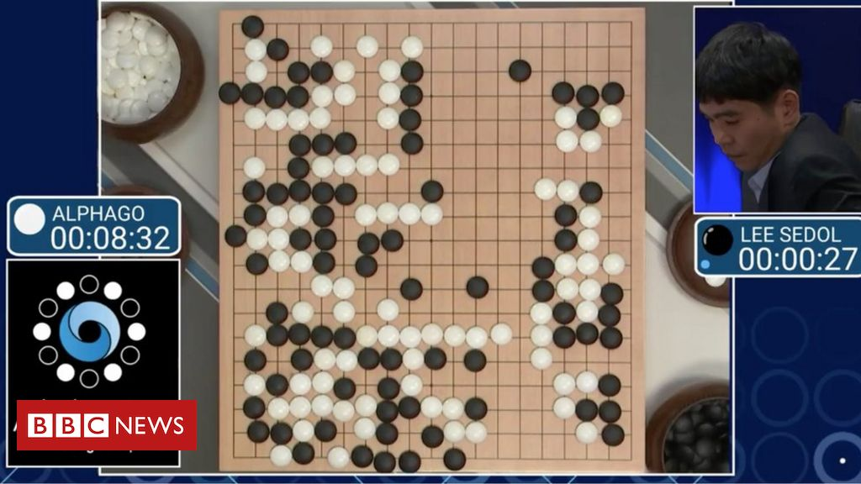
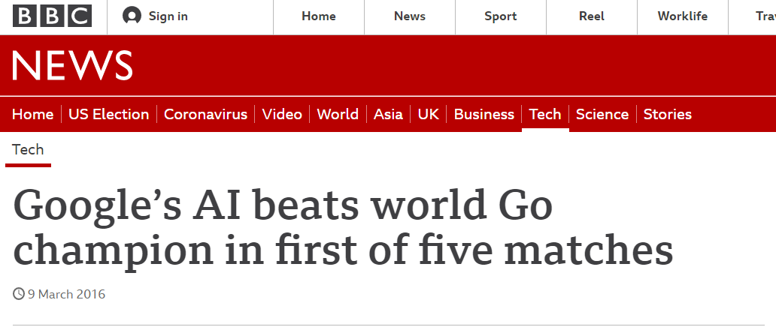
Notes:
Image from https://www.bbc.com/news/technology-35761246

Slide 39
Pop Quiz
Which type of Game/environment is Chess?
Perfect information, Episodic & Dynamic
Perfect information, Sequential & Static
Imperfect information, Episodic & Static
Imperfect information, Sequential & Dynamic
Notes:
B. Perfect information, Sequential & Static

Slide 40
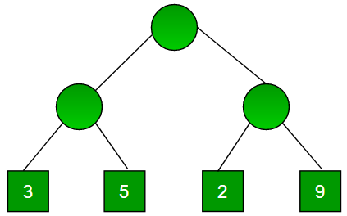
Minimax Search Strategy
Maximise one's own utility and minimise the opponent's utility
Assumption is that the opponent does the same → minimise your utility
Perfect decisions: no time limit is imposed
Generate the complete game tree from initial to terminal states
Calculate utility of terminal state and back propagate to parent of terminal state. Repeat the process till initial state is reached.
Select the move with the highest utility value.
* Note: Utility function - a numeric score to quantify the outcome of a game
Notes:
Diagram from https://www.geeksforgeeks.org/minimax-algorithm-in-game-theory-set-1-introduction/

Slide 41
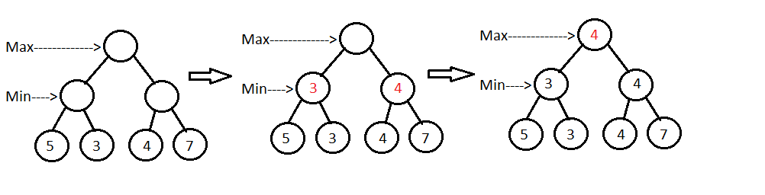
Minimax Search Strategy - Perfect Decision
Notes:
Image from https://www.baeldung.com/java-minimax-algorithm

Slide 42
Imperfect Decisions
Previous search strategy is intractable for games with a large branching factor!
Modify the minimax algorithm
Replace utility function with an evaluation function
Only do partial tree search (eg. depth of 2 or 3)
Evaluation function? There are numerous heuristics. Examples are:
Domain experts can advice on the probability of each state winning
Use of neural network
Notes:
Neural network was used in the case of AlphaGo

Slide 43
Pop Quiz
Which function is involved when the agent is deciding which choice to make and have no time limit imposed?
Utility function
Propagation function
Evaluation function
Minimax function

Slide 44
Agent Decision Making & Reinforcement Learning
Notes:
http://gki.informatik.uni-freiburg.de/teaching/ss14/gki/lectures/ai13.pdf

Slide 45
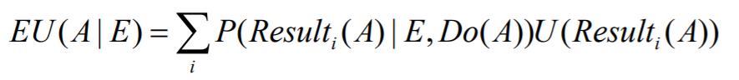
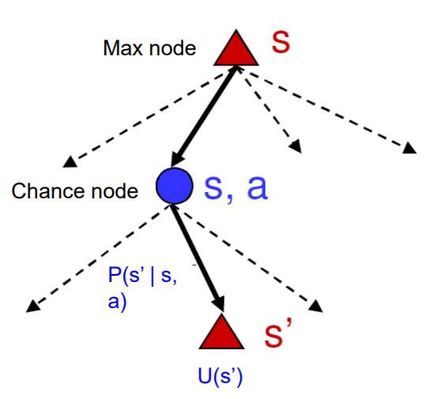
Utility theory
Expected utility:
Principle of maximum expected utility: Agent should choose action A under environment E that gives highest expected utility

Slide 46
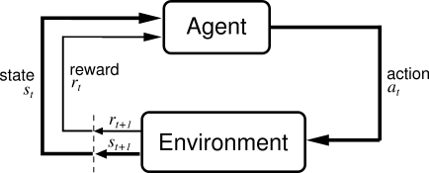
Agent-environment interface

Slide 47
Markov Decision Process (MDP)
Sequential decision making
Transition properties depend only on the current state (Markov Property)
State space S | Describes the possible “condition” of the agent
Action space A(s) | A set of actions a that the agent can take at state s
Transition model P(s’ | s, a) | Probability that the agent will reach state s’ from current state s by taking action a
Reward function R(s) | “Reward” for reaching state s. Total of these rewards to be maximised
Policy π(s) | The solution: optimal action to be taken at state s
Notes:
Transition model only dependent on s and a
https://en.wikipedia.org/wiki/Markov_decision_process

Slide 48
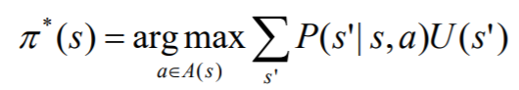
Utilities of state sequences
Goal: To have an optimal policy maximising expected utility over all state sequences (“true” utility of a state)
Problem: infinite state sequences = unbounded total utility
Solution: Recent reward counts more than previous rewards, discount factor γ
Optimal policy
Notes:
True utility = ground truth
EU = sum of individual reward, problem = infinite…
Utility is also state value function

Slide 49
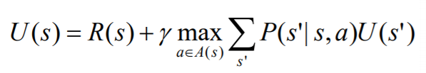
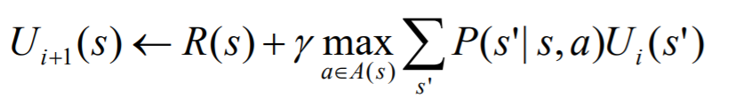
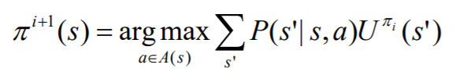
Bellman optimality equation
Value iteration
U = 0 for all states s
Policy iteration
Start with initial policy π₀
Calculate utility function using current policy
Notes:
Stanford lectures
https://www.youtube.com/watch?v=d5gaWTo6kDM
https://www.youtube.com/watch?v=9g32v7bK3Co
https://courses.grainger.illinois.edu/cs440/fa2018/lectures/lect30.html
https://courses.grainger.illinois.edu/cs440/fa2018/lectures/lect29.html

Slide 50
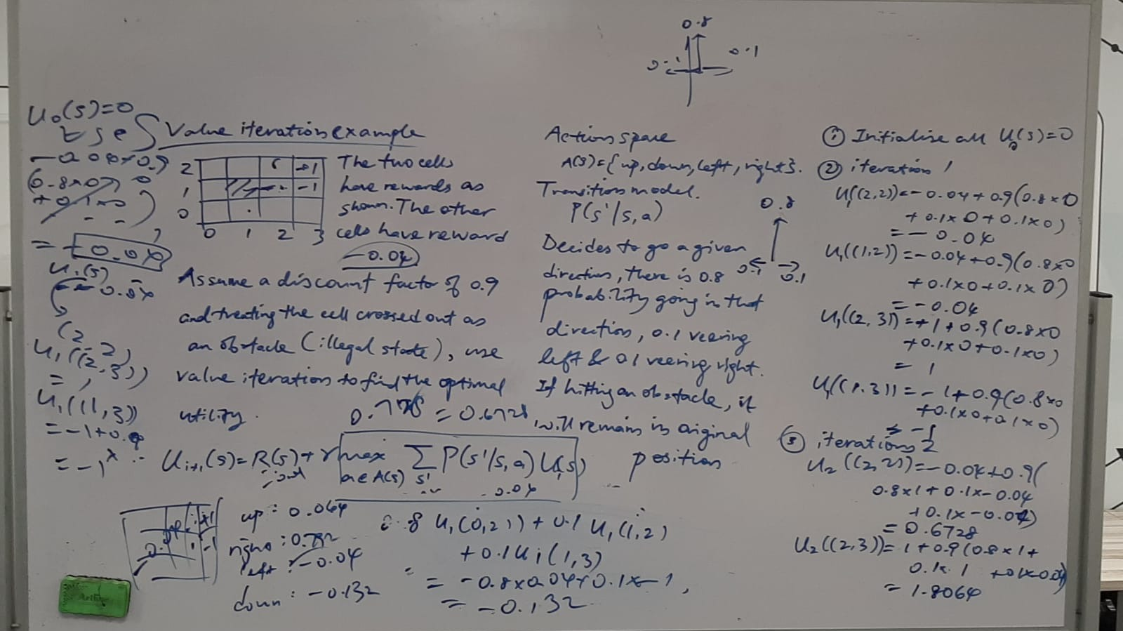

Slide 51
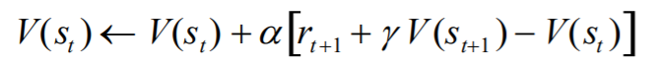
Temporal difference (TD) prediction
Does not require a model of the environment (e.g. transition model)
Fully incremental
Learn before knowing final outcome
Learn without knowing final outcome
Notes:
An incremental algorithm is given a sequence of input, and finds a sequence of solutions that build incrementally while adapting to the changes in the input.
https://en.wikipedia.org/wiki/Temporal_difference_learning
https://web.stanford.edu/group/pdplab/pdphandbook/handbookch10.html
r_(t + 1) + gamma V(s_(t + 1)) is unbiased estimate for V(s_t), alpha is learning rate. Similar to gradient descent

Slide 52
Pop Quiz
Refer to the iteration scheme above. Does the value of α affect the rate of convergence of the state value function? (Hint: Think gradient descent)
No, α depends only on the number of possible state.
Yes, it dictates how large is the correction step is.
No, the rate of convergence depends solely on γ.
Yes, the value of α must be larger than 1 to guarantee convergence.
Notes:
Answer is B. Similar to gradient descent, must ensure “critically damped”, and not overshoot like “underdamped”.
https://en.wikipedia.org/wiki/Temporal_difference_learning
http://incompleteideas.net/book/first/ebook/node63.html

Slide 53
Q & A

Slide 54
Thank you

Slide 55

We appreciate some feedback
https://forms.gle/EgnErxgjW743Jz1w6

Slide 56
Photo-taking

